Slide 1
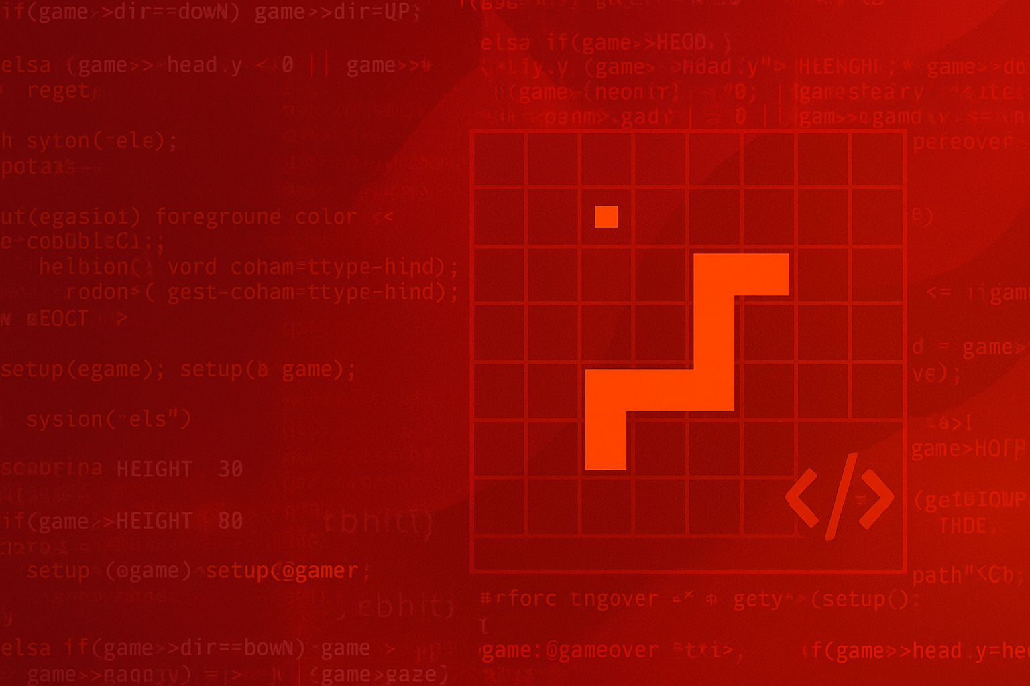


SNAKE GAME
GROUP – 4
Course code: CSE115.4

Slide 2


Slide 3
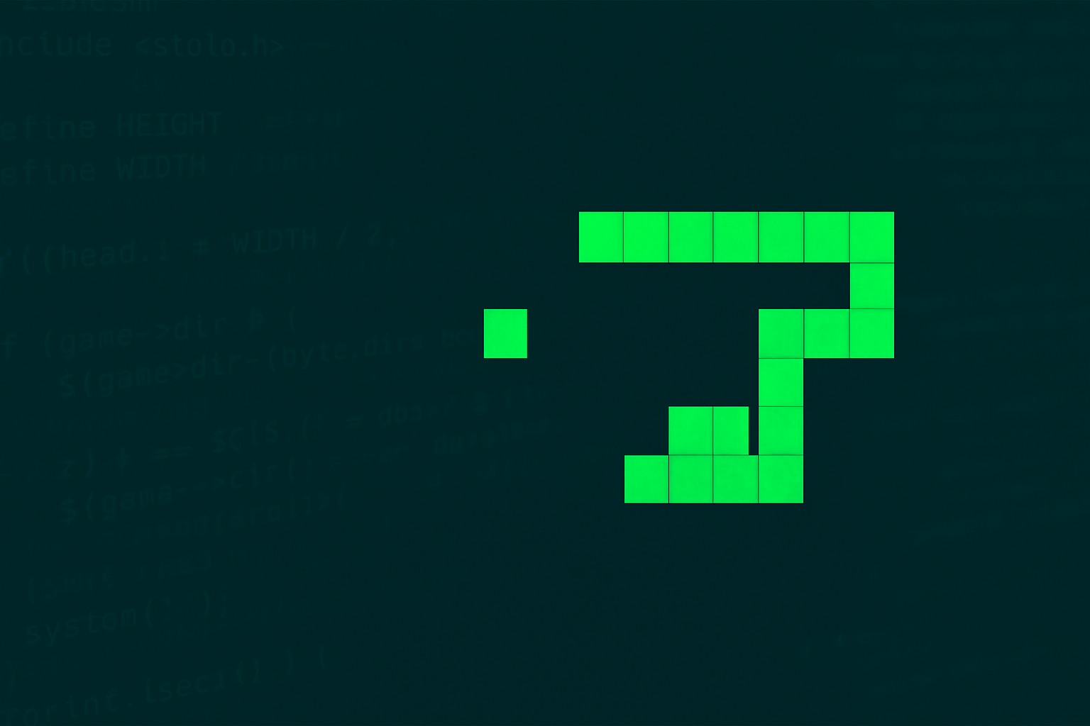
WHAT IS A SNAKE GAME?

Slide 4
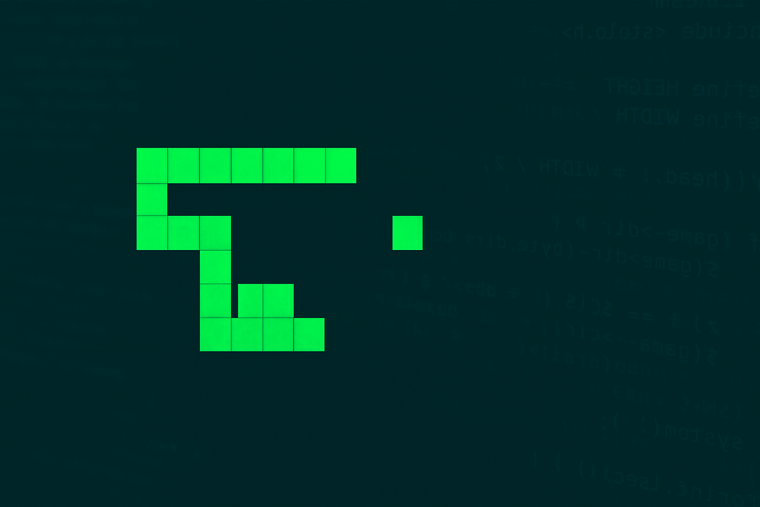
WHAT IS A SNAKE
GAME?
Control a snake to eat food and avoid crashes.

Slide 5

Why we choose it

Slide 6

Why we choose it?
Classic Programming Logic Demo
Real Time Input
Simple Graphics

Slide 7

Implement smooth snake movement
Add food spawning & scoring
Use clear modular code & GitHub version control
Handle self-collision logic
OBJECTIVES

Slide 8
System Architecture
Setup
Draw
Input
Logic
Repeat

Slide 9
System Architecture
POSITION
GAMESTATE
Key structs

Slide 10
Basic movement works
Wall collision detection
Current Progress

Slide 11

Food generation & self-collision in progress
Current Progress

Slide 12
GitHub repo active
Current Progress

Slide 13
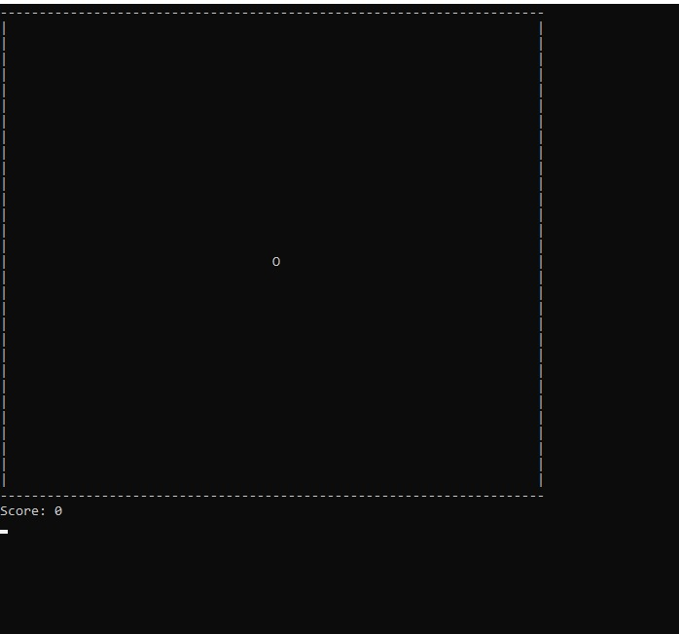
Demo screenshot

Slide 14
Console flickering
with system("cls")
Challenges
Smooth input with _kbhit() & _getch()
Body segment tracking
For self-
collision

Slide 15
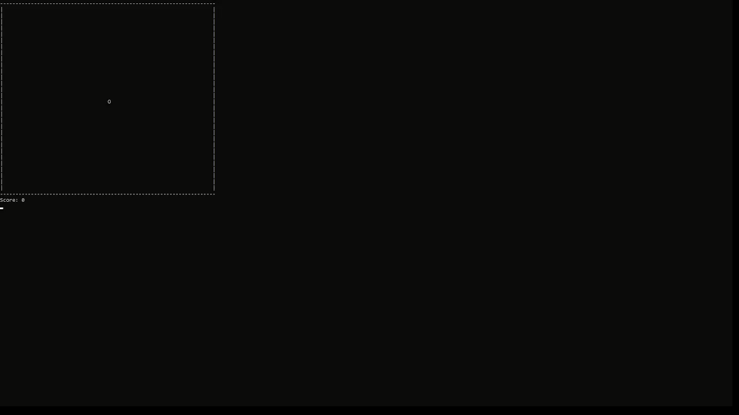
Smooth input with _kbhit() & _getch()
Challenges

Slide 16
Next steps
Implement random food
Prepare final report
Grow snake on food
Finalize self-collision

Slide 17
Thank you
0

